Slide 1
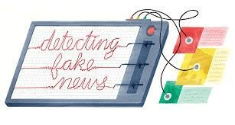
Fake News Detection
Group members:
201p001 Faizan Hussain
201p048 Salman
201p048 Ansh Tiwari
201p040 Suchit Sawant

Slide 2


Introduction

Slide 3

Importance Of Fake News Detection
It's crucial because fake news can trick people into believing things that aren't true. This can lead to wrong decisions, misunderstandings, and even ﬁghts.
Detecting fake news helps protect us from these made-up stories. It keeps us safe, helps us make bet er choices, and ensures we can trust what we read online

Slide 4

Manually detecting fake news is a daunting task due to several challenges:
Why We used Technology
Large Volume of Content
Time-Consuming Human Error
Limited Expertise

Slide 5


Project Implementation
We are using Python Programming language for this project.
On our dataset, we create a
Tﬁdf Vectorizer with sklearn. The model is then ﬁtted using a PassiveAggressive Classiﬁer that has been initialised.
Finally, the accuracy score and the
confusion matri indicate how well our model performs.

Slide 6
Conclusion
As we conclude, remember that the ﬁght against fake news is not a one-time battle; it's an ongoing commitment. Our ability to use technology responsibly and ethically will be the linchpin in creating a trustworthy and informed digital landscape. So, armed with Python and knowledge, let's stand vigilant and continue the quest for truth in the age of information. Thank you for joining us on this journey.

Slide 7
Thanks!

